Slide 1
Triads

Slide 2
Levels of Analysis in social networks
Individual
1
Dyads
2
Triads
3
Cliques, Communities
4
Whole Network
5
The first part of the course follows this organization!

Slide 3
Levels of Analysis in social networks
Individual
1
Dyads
2
Triads
3
Cliques, Communities
4
Whole Network
5
The first part of the course follows this organization!

Slide 4
Triadic processes
Triadic configurations exhibit properties not reducible to (but still dependent on) dyadic processes (Simmel 1908)
  "Simplest" configuration that exhibit "group" properties (e.g. factionalization, alliance formation, brokerage, etc.)
A series of social network theories in rely on triadic processes:
  Balance Theory
  Granovetter's "Strength of Weak Ties" (SWT) theory
  Simmelian Ties Theory
  Structural Holes (SH) Theory

Slide 5

Balance theory
Building blocks
  A set of actors
  A set of (directed) relationships defined on those actors
  For example: Likes and Dislikes

Slide 6
Balance theory
Considering triads containing directional arcs
  This is the key to balance theory
    Solid lines are positive sentiments
    Null (dashed) lines are negative sentiments

Slide 7
Balance theory
In balance theory, each vertex in the configuration is given a designation
  Person (P): "The individual whose behavior is being predicted by the theory" (Davis 1963: 445).

Slide 8
Balance theory
In balance theory, each vertex in the configuration is given a designation
  Other (O): An object (e.g another individual) towards which P is oriented.

Slide 9
Balance theory
In balance theory, each vertex in the configuration is given a designation
  Q: A third object (a value, group or another individual) towards which P and O are oriented.

Slide 10
Balance theory
The basic premise of the theory is that people are motivated to seek balance in the triadic configurations in which they are embedded.

Slide 11
Structural balance theory
Balance is formally defined as the sign of the product of the weights attached to each edge in the cycle.
  Positive triads are balanced
  Negative triads are imbalanced

Slide 12
Balance theory
PQ |  | OQ |  | PO |  | POQ

Slide 13
Balance theory
Balance is formally defined as the sign of the product of the weights attached to each edge in the cycle.
  Balance reduces “tension” and is experienced as satisfactory (stable equilibrium)

Slide 14
Balance theory
Balance is formally defined as the sign of the product of the weights attached to each edge in the cycle.
  Imbalance is experienced as tension and discomfort (unstable state) that must be resolved (balanced)

Slide 15

Balance theory
Balance is formally defined as the sign of the product of the weights attached to each edge in the cycle.
  Imbalance is experienced as tension and discomfort (unstable state) that must be resolved (balanced)

Slide 16
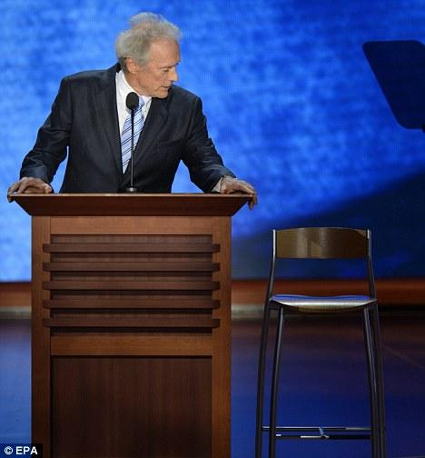
Balance theory
Balance is formally defined as the sign of the product of the weights attached to each edge in the cycle.
  Imbalance is experienced as tension and discomfort (unstable state) that must be resolved (balanced)
Republican Party
You
Clint Eastwood

Slide 17
Balance theory
Balance is formally defined as the sign of the product of the weights attached to each edge in the cycle.
  Imbalance is experienced as tension and discomfort (unstable state) that must be resolved (balanced)
You either become a Republican and keep liking Clint Eastwood movies
Or
Decide that Clint Eastwood was an overrated hack anyways!
Republican Party
You
Clint Eastwood

Slide 18
Balance theory
Balance "rules"
  If P likes O, and O likes Q, P likes Q
  If P likes O, and O dislikes Q, P dislikes Q
  If P dislikes O, and O likes Q, P dislikes Q
  If P dislikes O and O dislikes Q, P likes Q

Slide 19
Balance theory
Balance "rules"
  If P likes O, and O likes Q, P likes Q
  If P likes O, and O dislikes Q, P dislikes Q
  If P dislikes O, and O likes Q, P dislikes Q
  If P dislikes O and O dislikes Q, P likes Q

Slide 20
Balance theory
Balance "rules"
  If P likes O, and O likes Q, P likes Q
  If P likes O, and O dislikes Q, P dislikes Q
  If P dislikes O, and O likes Q, P dislikes Q
  If P dislikes O and O dislikes Q, P likes Q

Slide 21
Balance theory
Balance "rules"
  If P likes O, and O likes Q, P likes Q
  If P likes O, and O dislikes Q, P dislikes Q
  If P dislikes O, and O likes Q, P dislikes Q
  If P dislikes O and O dislikes Q, P likes Q

Slide 22

Balance theory
Considering relations of multiple others in relation to the same object can lead to more complex mixtures of balance and imbalance:
  The “cross-pressure” situation
Q

Slide 23
Why are triads so special?
Simmel’s Model:
  Triads are qualitatively different from dyads
  Dyads embedded in reciprocally strong triads are not the same as standalone dyads
    People in a standalone dyad are more “their own person”
      Have more individuality
      More potential for unresolved differences
    People in an embedded (Simmelian) dyad can be “outvoted”
      Hence more likely to conform to the “group”
      Less individuality and autonomy

Slide 24
Why are triads so special?
Simmel’s Model:
  Triads are qualitatively different from dyads
  Dyads embedded in reciprocally strong triads are not the same as standalone dyads
    People are “power-symmetric” in a standalone dyad:
      If either withdraws relationship dissolves
    Any one ego is experiences “power-asymmetry” (dependence) in an a triad:
      S/he can withdraw but the other two people still have a relationship
      S/he loses the benefits of two relationships
        Each other ego only loses one

Slide 25
Why are triads so special?
Simmel’s Model:
  Triads are qualitatively different from dyads
  Dyads embedded in reciprocally strong triads are not the same as standalone dyads
    Explains why conflict is more difficult to settle in standalone dyads
    Explains why sometimes only conflict resolution recourse is to turn the standalone dyad into a “temporary” Simmelian dyad:
      Arbitration
      Mediation
    Research shows that third parties are useful in alleviating dyadic conflicts

Slide 26
Why are triads so special?
Simmel’s Model:
  Triads are qualitatively different from dyads
  Dyads embedded in reciprocally strong triads are not the same as standalone dyads
    Networks with closed triads feature two (mutually exclusive) types of ties:
      Simmelian ties
        Dyads embedded in triads
      “Regular” (non-Simmelian) ties
        Stand alone dyads
    Simmelian ties are more durable
    Simmelian ties are stronger

Slide 27
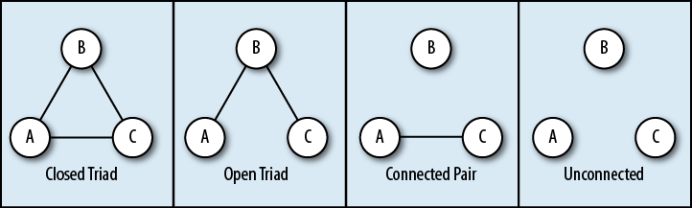
Triadic relations in networks
How many types of triads are there?
  In an undirected graph:
    Null (unconnected) triad
    Connected pair + unconnected third party
    Open triad
    Closed triad

Slide 28

Transitivity
Refers to the tendency in human social networks for open triads to transition into closed triads
  Akin to Mathematical transitivity
  Relation R is transitive iff:
    aRb, and bRc jointly imply aRc
    Equality, Less than, Greater than, etc.
      If 4 > 3 & 3 > 2 then 4 > 2
  Same reasoning can apply to social relationships:
    If A is friends with B and B is friends with C then A is friends with C

Slide 29
Theories of transitivity
Balance Theory
  Open triad
  Ego feels psychological pressure
  Ego relieves pressure by closing (e.g., introducing unconnected alters)
    Mechanism: Ego-driven link formation
Psychological Pressure

Slide 30
Theories of transitivity
Theory of Social Foci
  Empty triad
  Actors participates in common focus/joint activity
  Closed triad (3-clique)
    Mechanism: Context-driven link formation
Social
Foci

Slide 31
Theories of transitivity
Strength of Weak Ties Theory
  Open triad with strong links
  Depending on strength
  Triad will either close or remain open
    Mechanism: Strength-driven link formation
Strength Effect

Slide 32
Theories of transitivity
Strength of Weak Ties Theory
  Open triad with weak links
  Depending on strength
  Triad will either close or remain open
    Mechanism: Open triads stay that way if the links are weak
Weak Tie Effect

Slide 33
Theories of transitivity
Structural Holes Theory
  Unbalanced triad
  Ego gains control benefits from it
  Ego works to keep it from closing
    Mechanism: Ego-driven brokerage
Ego works to keep open

Slide 34
Theories of transitivity
Simmelian Tie Theory:
  Closed triad
  Simmelian tie effect
  Triad stays closed
    Mechanism: Triads have “top-down” effects on the dyads that compose them
All actors work together to keep ties from dissolving

